Slide 1
Computer Graphics
Lecture 7: Monte Carlo Integration
Kartic Subr

Slide 2
Using randomness
Georges-Louis Leclerc, Comte de Buffon
(1707-1788)

Slide 3
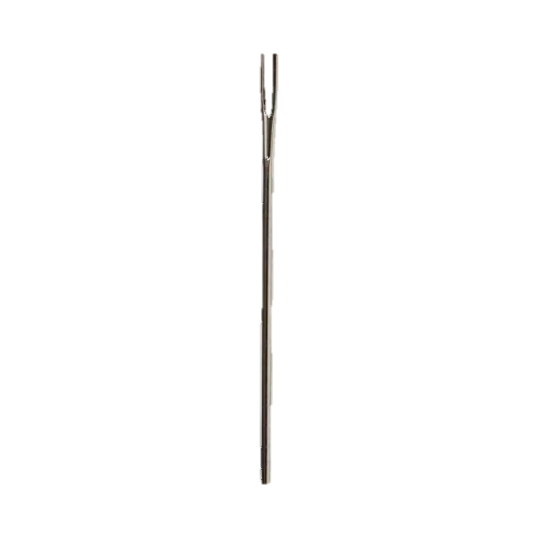

Using randomness
Suppose we have a floor made of parallel strips of wood, each the same width, and we drop a needle onto the floor. What is the probability that the needle will lie across a line between two strips?
t
$ℓ$< t
Georges-Louis Leclerc, Comte de Buffon
(1707-1788)

Slide 4
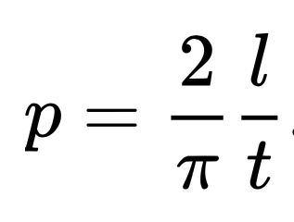
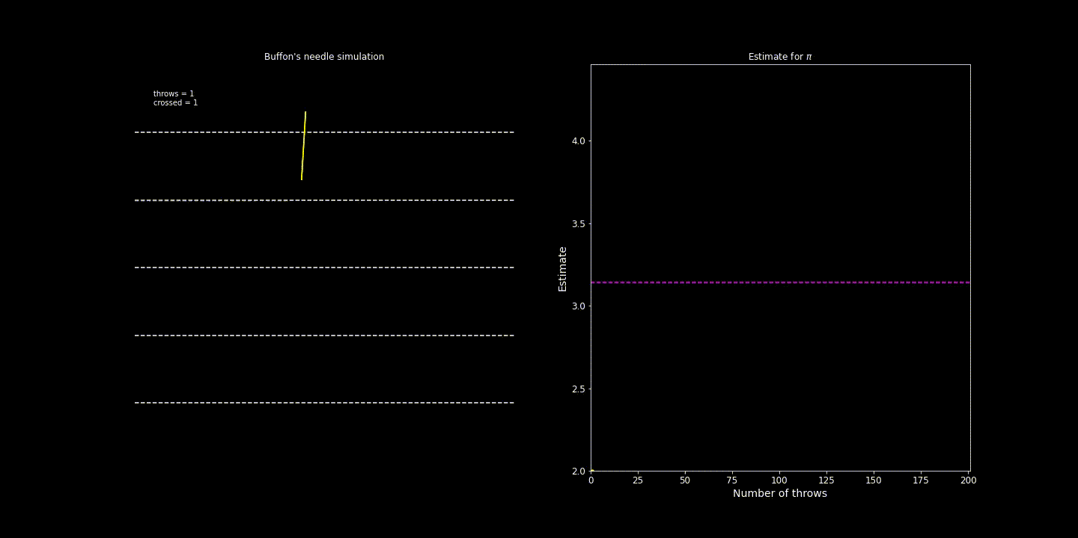
Using randomness
https://people.orie.cornell.edu/sbanerjee/courses/orie4580f20/
http://dmcpress.org/cm/buffon/experiment.html

Slide 5
Random variables: refresher

Slide 6
Numerical integration using random samples

Slide 7
From integrating circles to general functions

Slide 8
Formally …

Slide 9
Importance sampling: intuition

